Slide 1
KU-EDW-DATA-PT-07-2020-U-C Project 1
Presented By: The Four Loopers
Hali Bielser, Kristen Harnack, Mindy Ketchum & Brittany Oullette

Slide 2
Motivation & Summary
Notes:
After determining sources, had to bring all data together to perform desired analysis

Slide 3
If a county has poor socioeconomic factors, then the preventable hospitalization rates will be higher and vice versa.
Does access to exercise opportunities result in a lower preventable hospitalization rate?
Does income affect the preventable hospitalization rate?
Does mental/physical wellbeing have an impact on the preventable hospitalization rate?

Slide 4
What affects healthcare outcomes?
Weather
Income
Parks / Recreation access

Slide 5
How does preventable hospitalization rate correlate to various environmental and social factors by county?

Slide 6
Questions & Data
Notes:
After determining sources, had to bring all data together to perform desired analysis

Slide 7
Current Status
Data Exploration and Clean Up Process
Cleanse and Prepare Data
Transform and Develop Data
Research Sources and Gather Data

Slide 8
Data Cleanup & Exploration
Notes:
After determining sources, had to bring all data together to perform desired analysis

Slide 9
Exploration & Cleanup Process
Understand
data
Narrow
focus
Prepare
data
Notes:
Understanding data
County Health Rankings (CHR) had wealth of information
Hours spent reviewing documentation/asking additional questions
Meanings of ratios
How data were grouped
Narrow focus
Continued to think about other comparisons but had to narrow focus
Created filtered dataframe that contained only information we could analyze within given timeframe
Decided to look at top and bottom 20 counties within U.S. based on % fair health
Prepare data
Ranking assigned in CHR was not what we wanted to analyze
By state, not entire country
Added state and location (latitude/longitude) to dataframe to allow for geoanalysis

Slide 10
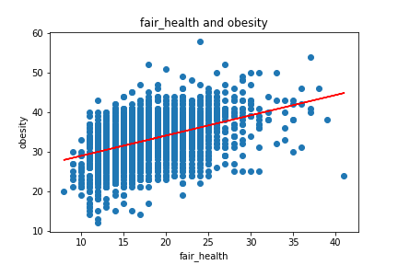
Unanticipated Insights
Weak correlation between fair health and obesity (.193)
Notes:
Initially overwhelmed by amount of data available for U.S. counties
Went through plethora of comparisons/analyses
Surprised by weak correlation between fair health and obesity
Obesity defined as adults reporting BMI >30
Respondents may not have been truthful or understood how to define themselves as obese

Slide 11
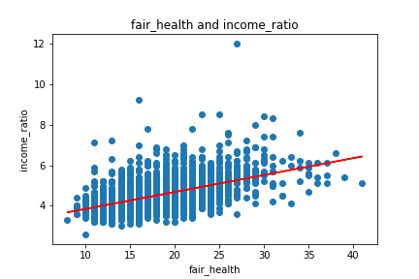
Unanticipated Insights
Weak correlation between fair health and income ratio (.286)
Notes:
Weak correlation between fair health and income ratio
Income ratio = ratio of household income at 80th percentile of median household income to income at the 20th percentile
Thought that there would be stronger correlation – lower ratio would see higher health since less of a gap

Slide 12
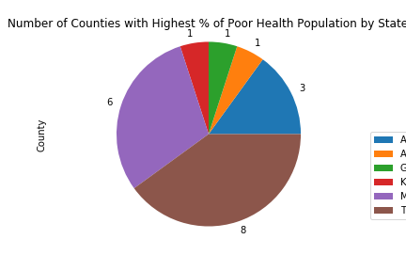
Unanticipated Insights
Poor health concentrated in southern states
Notes:
20 highest-ranking counties with poor health fell into 6 states

Slide 13
Unanticipated Challenges
Data preparation
Initial data point
Accuracy of data
Task distribution
Notes:
Challenging to get data into desired format for analysis
Wanted to show all of a certain place type in relation to county
“Nearby” just returns nearest place type
Would like to see if counties with higher fair health scores have more parks, gyms, health care providers, etc.
Previously mentioned that “Preventable Hospital Stays” limited to Medicare Enrollees
Could have looked for other data source to try to get this for entire population
Data accuracy
Were respondents truthful about alcohol consumption, obesity, mental/physical health, etc.?
Research tasks
Tried doing some research individually but kept regrouping because new questions arose
Found it more effective to assign certain tasks to each person then work through each as group
Assisted in real-time

Slide 14
Data Analysis
Notes:
After determining sources, had to bring all data together to perform desired analysis

Slide 15
Team Resources
State assumptions about resources allocated to this project.
People
Equipment
Locations
Support & outside services
Manufacturing
Sales

Slide 16
Procedures
Highlight any procedural differences from usual projects of this type.
Discuss requirements, benefits, and issues of using new procedures.
-for more info…List location or contact for specification (or other related documents)

Slide 17
Schedule
Review high-level schedule.
-for more info…List location or contact for specification (or other related documents)

Slide 18
Related Documents
Marketing plan
Location or contact name/phone
Budget
Location or contact name/phone
Post-mortem
Location or contact name/phone
Submit questions
Location or contact name/phone

